Slide 1
ECE/CS 552: Single-Cycle Control Path
Boone Severson
Lecture notes based in part on slides created by Joshua San Miguel, Mikko Lipasti, Mark Hill, David Wood, Guri Sohi, John Shen and Jim Smith

Slide 2
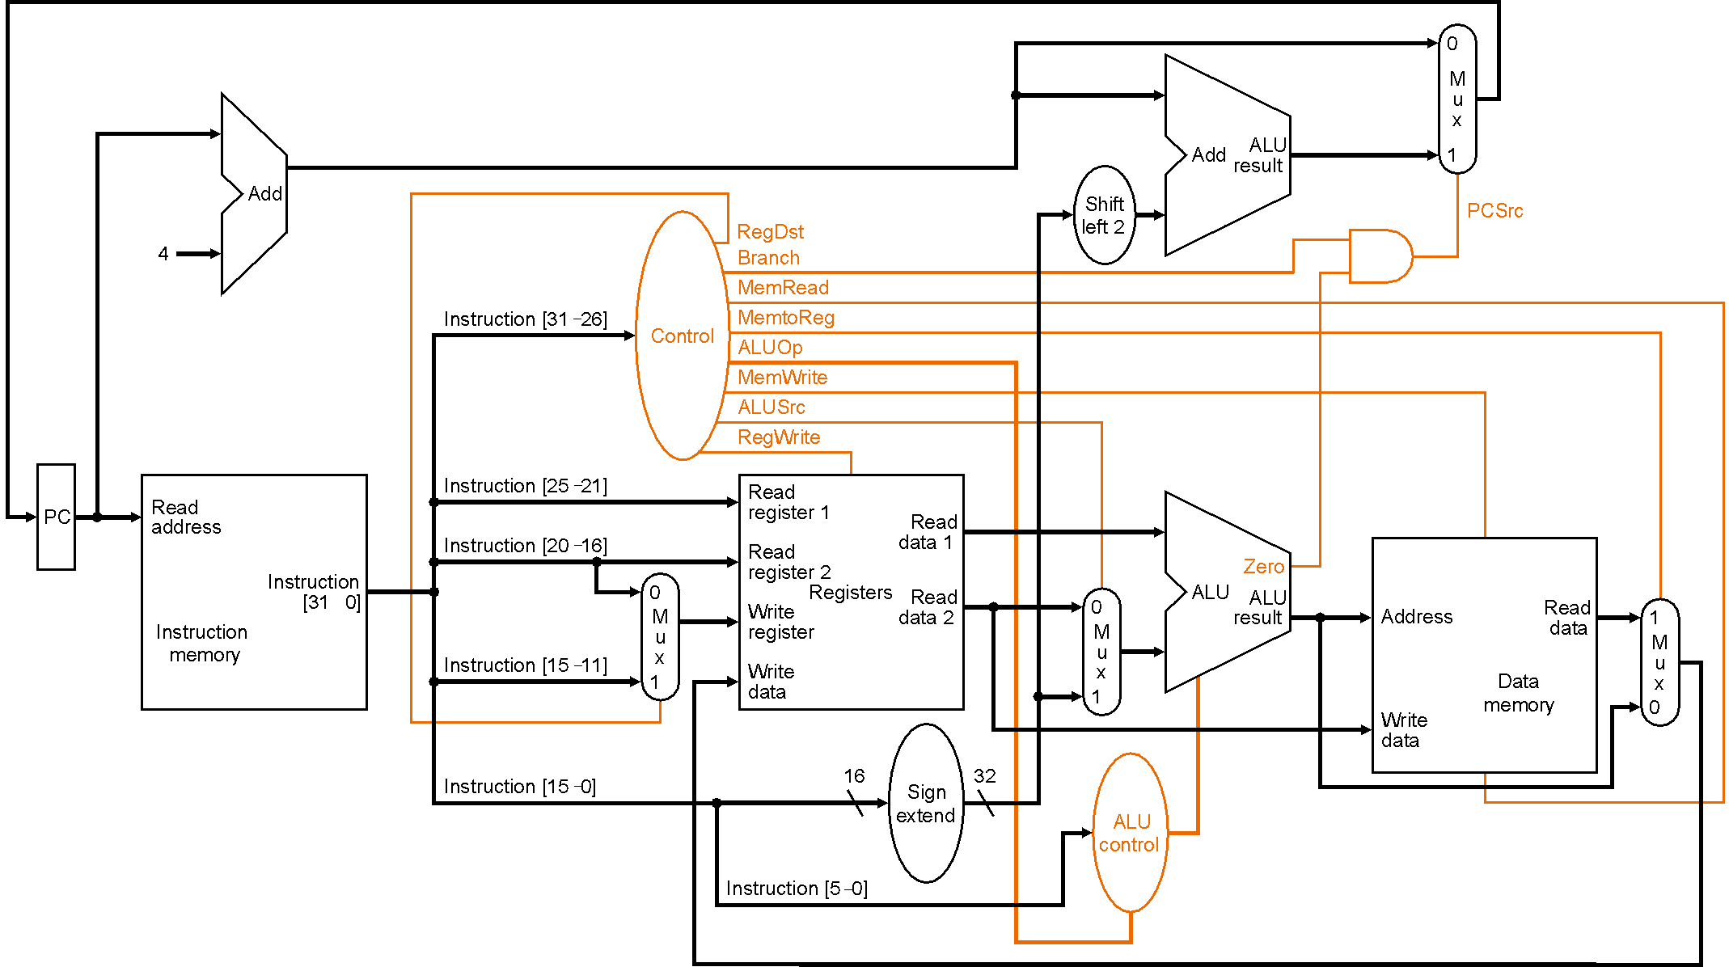
Global Control

